Slide 1

Knight Bites
Aayam Shrestha
Anjana Sainju
Charles Duimstra
Ifeanyi Onyeanakwe

Slide 2
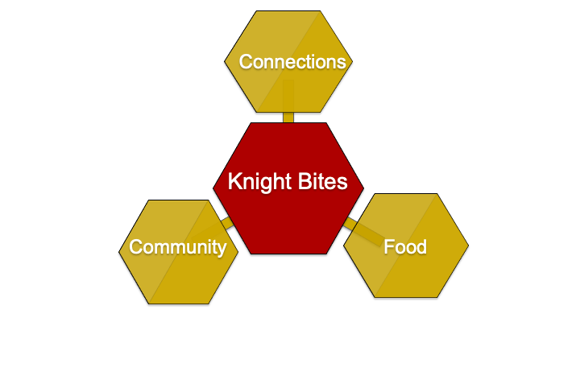
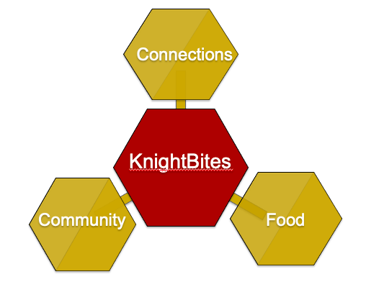
Our Vision
KnightBites

Slide 3
Demo

Slide 4
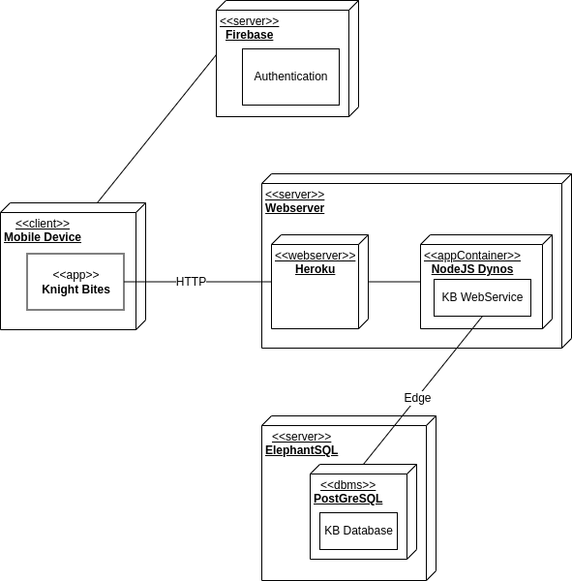
Deployment Diagram

Slide 5
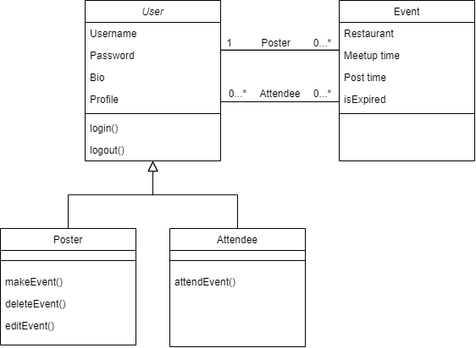
Domain Model
picture

Slide 6
Database Schema
Student(email, firstName, lastName, bio)
Restaurant(name, address, openingTime, closingTime, priceRange, discount)
Post(studentEmail, restaurantName, restaurantAddress, postTime, meetupTime)

Slide 7
Status Report
Posts and Comments
Profiles
Metadata
Ease of Use

Slide 8
Achievements
Profiles are viewable.
Intuitive User Interface.
CRUD operations on posts.
Changes based on user tests.

Slide 9
Questions?

